Slide 1


Exploiting Spatiotemporal Correlations of Arrive-Stay-Leave Behaviors for Private Car Flow Prediction
Chenxi Liu*, Zhu Xiao*, Dong Wang*, Lei Wang*, Hongbo Jiang*, Hongyang Chen^, Jiangxia Yu‘
*Hunan University
^Zhejiang Lab
‘Xidian University
IEEE TNSE, Jan 04 2022

Slide 2
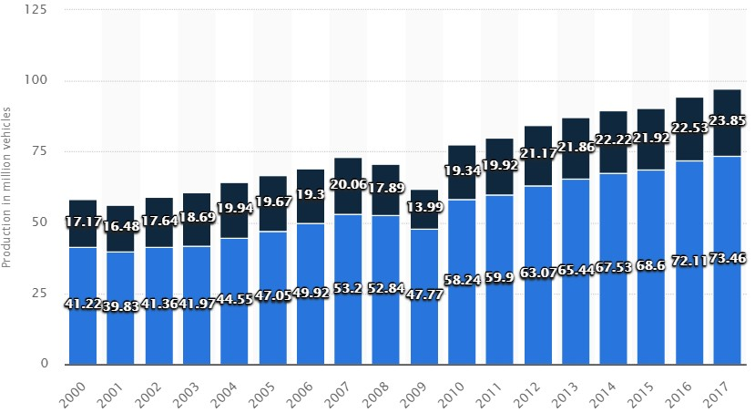
Background
At the end of 2021, the number of private cars in China accounts for 79.8% of automobiles, up to 237 million.
Public transit
Private car
2000-2017 World Automobile Production Volume Trend
2015-2021 The Number of Small Passenger Vehicles and Private Vehicles in China (Unit: 100 million vehicles)

Slide 3
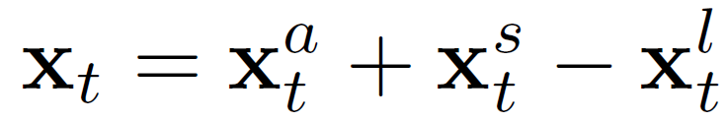
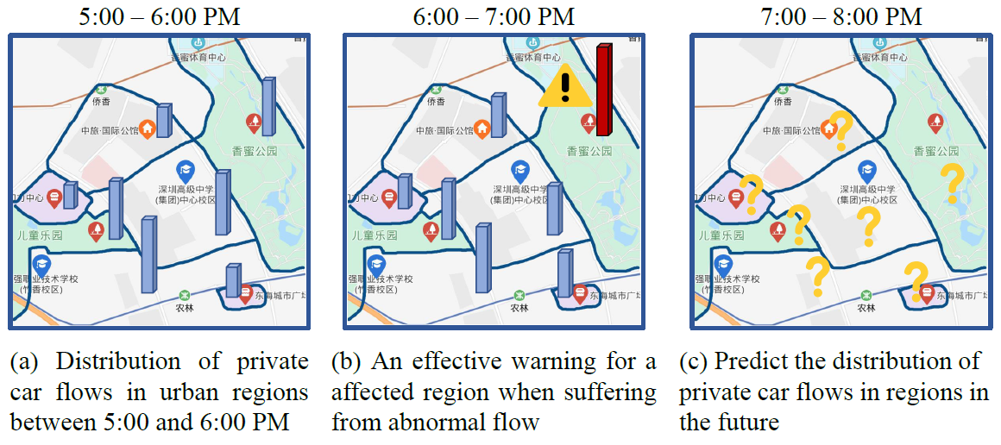
Private Car Flow Prediction
Private car flows are primarily reflected in the arrive-stay-leave (ASL) behaviors of car users.
They are different from other types of car flows (e.g., taxi demands or bicycle flows), which only consider arrival (inflow) or leave (outflow) and ignore the original stay volumes of cars.
Private Car Flow = Stay Volume + Arrival Flow – Leave Flow

Slide 4
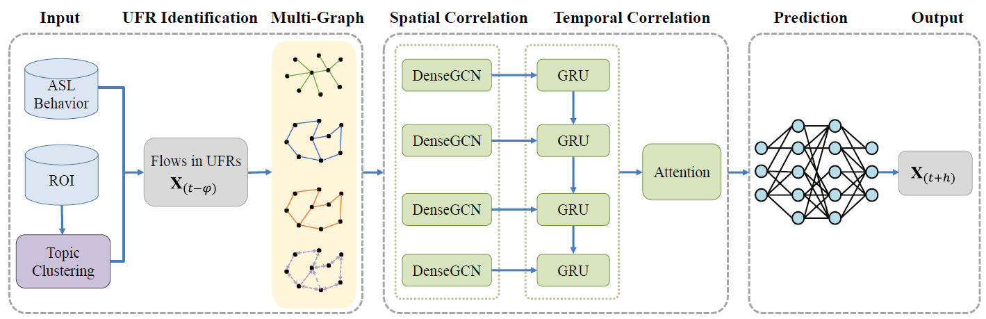
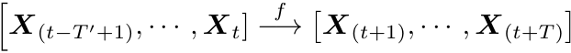
MultiGraph Dense Convolutional Network (MGDCN)

Slide 5
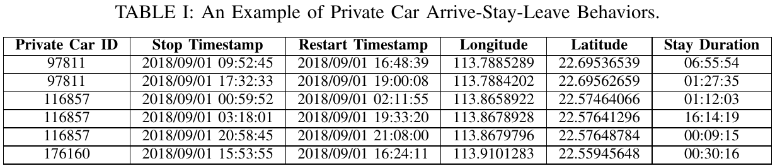
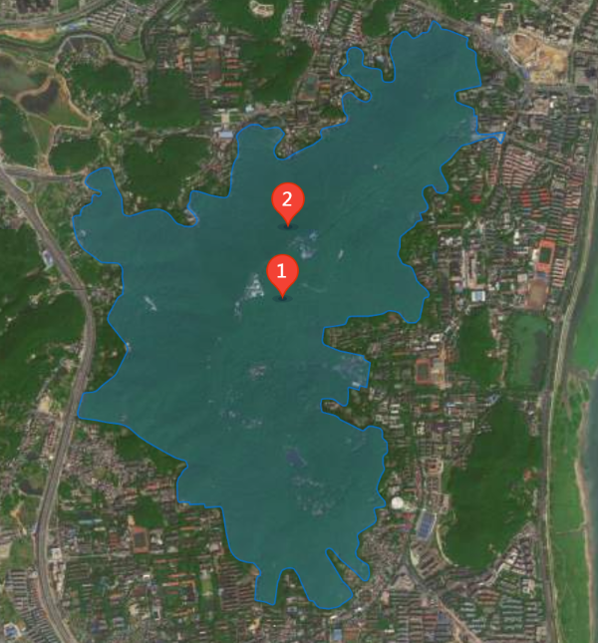
Input of MGDCN
ROIs (Regions-of-Interest) refer to integrating irregular urban regions with specific functions.
For example, Yuelu Mountain in the figure.

Slide 6
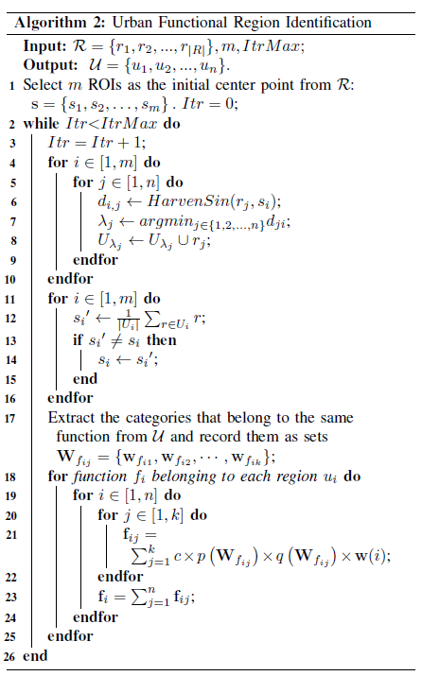
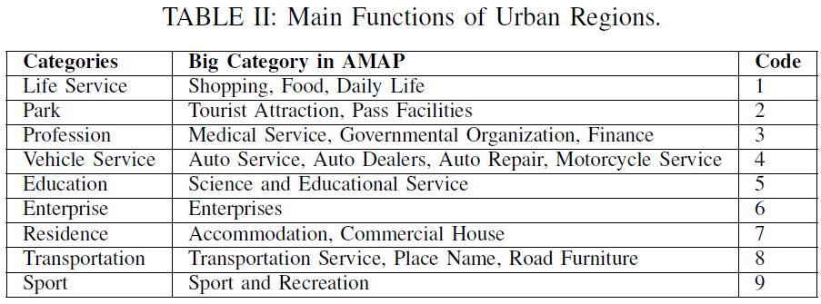
UFR Identification

Slide 7
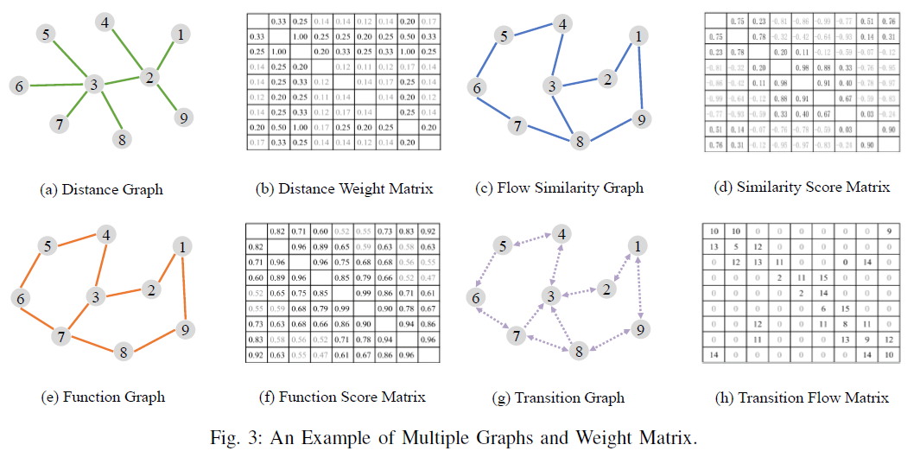
Multi-Graph

Slide 8
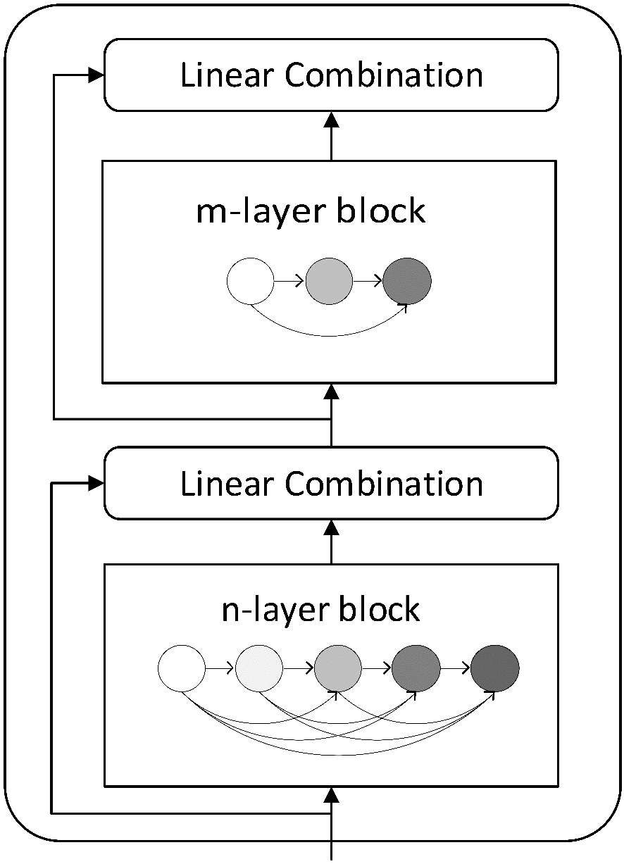
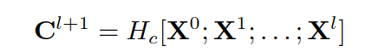
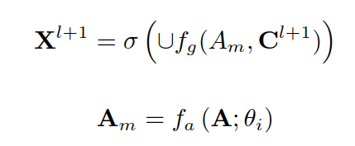
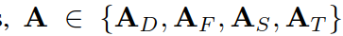
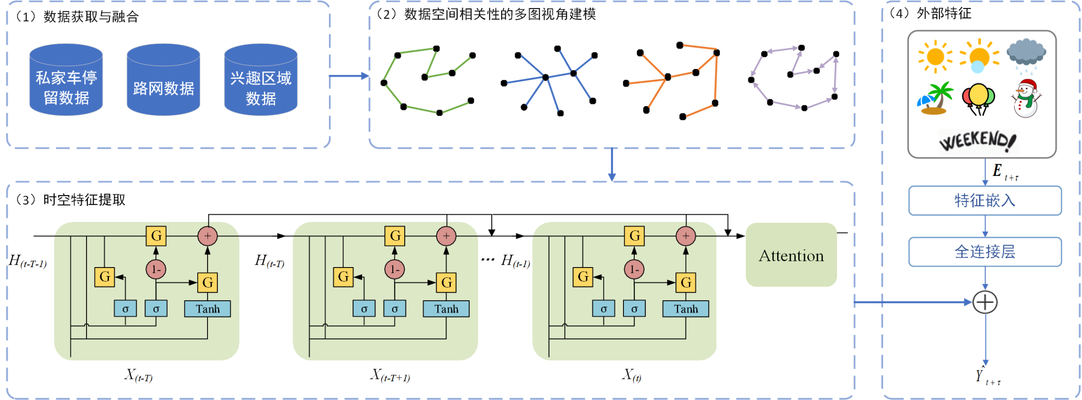
Spatial Correlation
Graph Convolution Networks
with Densely Connected Blocks
Each block
Notes:
DenseGCN

Slide 9
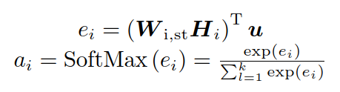
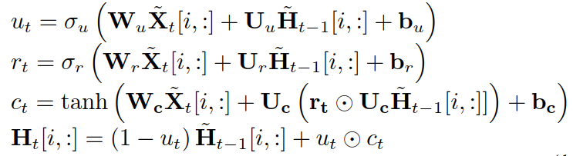
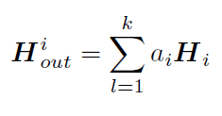
Temporal Correlation
(1) Sequence Temporal Correlation:
Multigraph Dense Convolutions with
Gated Recurrent Units
(2) Stay Duration Correlation:
Attention Network

Slide 10
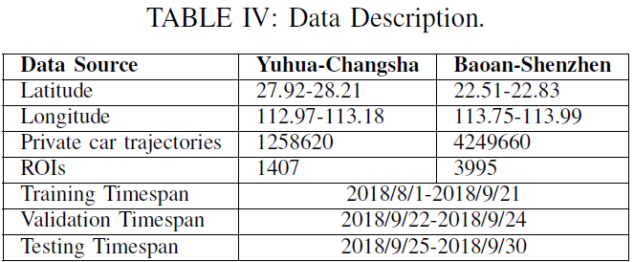
Experiments
Baselines | Category
HA | Statistics
ARIMA
BO-SVR | Machine Learning
GBRT
Multi-LSTM | Deep Learning
T-GCN
DCRNN
GraphWaveNet
GMAN

Slide 11
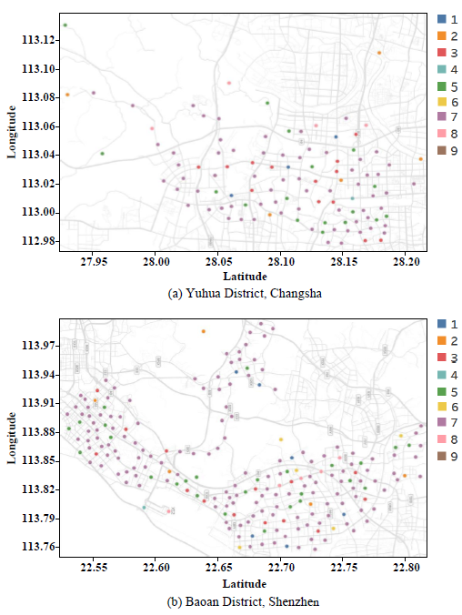
Experiments
Distribution of Center Points of 109 Functional Regions in Yuhua District, Changsha
Distribution of Center Points of 210 Functional Regions in Baoan District, Shenzhen

Slide 12
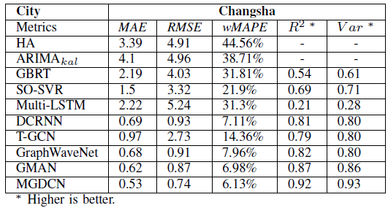
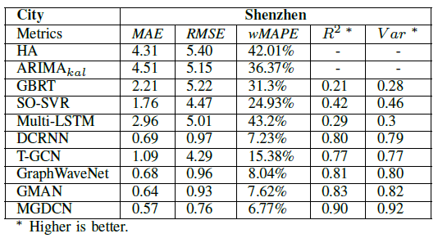
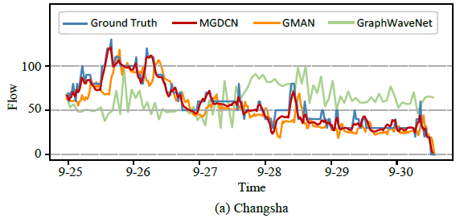
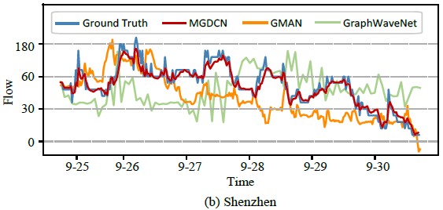
Experiments
All Regions
Single Region

Slide 13
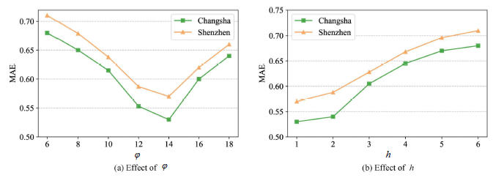
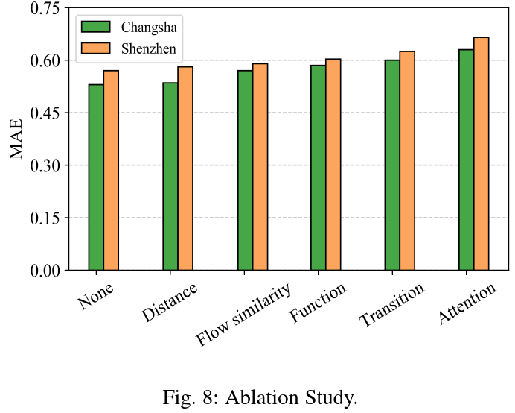
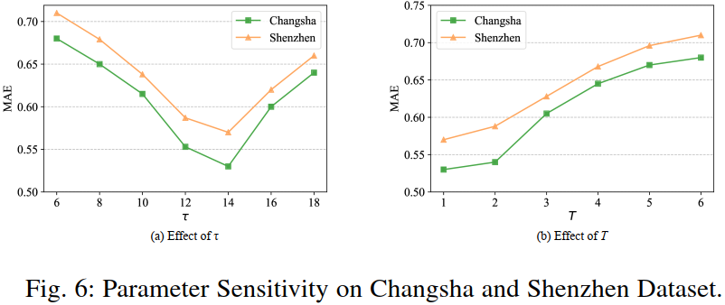
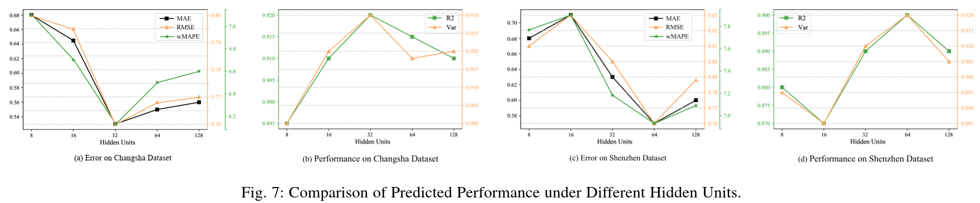
Experiments

Slide 14
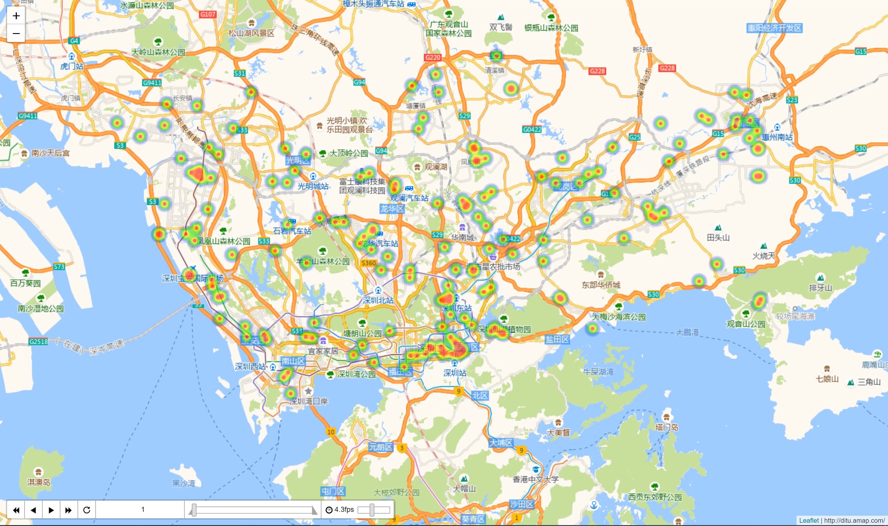
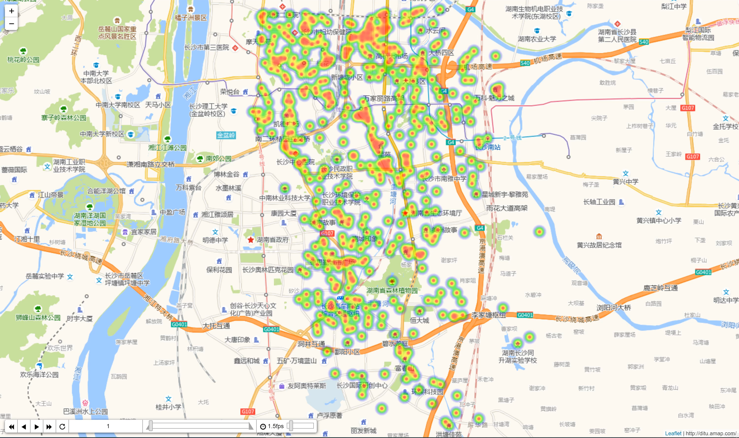
Case Visualization
Predicted Private Car Flows in Shenzhen
τ = 1 h
Predicted Private Car Flows in Yuhua District, Changsha
τ = 1 d
Notes:
September 1, 2018

Slide 15
Conclusion
We predict private car flows in urban functional regions by exploiting spatiotemporal correlations of arrive-stay-leave (ASL) behaviors of private car users.
We propose a topic clustering algorithm to identify urban functional regions.
We model the distribution of private car travel in functional regions through multiple perspectives.
We propose the MGDCN (MultiGraph Dense Convolutional Network), which extends the densely connected block to a multi-graph convolutional network to extract the global spatial correlations of private car flows.
In addition, a convolutional gated recurrent unit extracts the sequential temporal correlation of private car flow and attention networks learns the correlation of the stay duration in each region.

Slide 16
Discussion and Future Work
Smart parking.
Risk assessment.
Public transportation planning.
In the future, we will integrate multisource heterogeneous data, such as weather, holidays, important events, and city populations, to more comprehensively predict private car flows or OD flows.

Slide 17
Q & A
THANKS FOR WATCHING

